Slide 1
DevOps Moldova Community
Networking, HTTP and API

Slide 2

Agenda
How can I send some data over the internet?
Why do I need an IP address?
IP addresses are complicated I need DNS
How HTTP works?

Slide 3

Hey, I wanna send you something

Slide 4
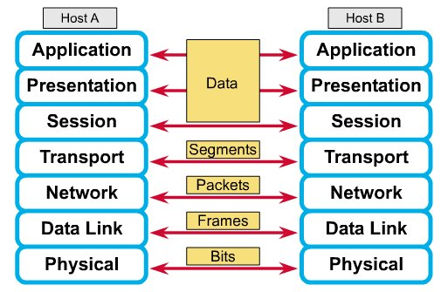
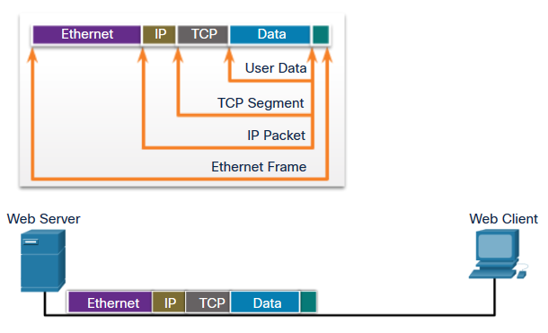
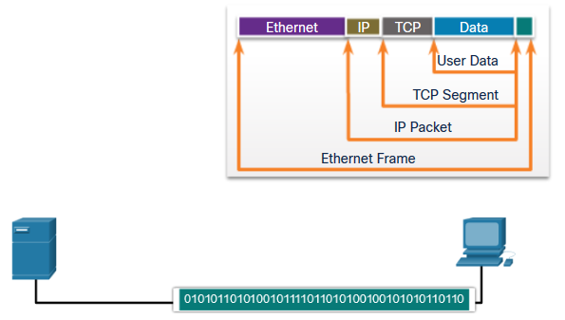
End to end connectivity
Each layer contains a Protocol Data Unit (PDU)
PDU’s are used for peer-to-peer contact between corresponding layers.
Data is handled by the top three layers, then Segmented by the Transport layer.
The Network layer places it into packets and the Data Link frames the packets for transmission.
Physical layer converts it to bits and sends it out over the media.
The receiving computer reverses the process using the information contained in the PDU.

Slide 5
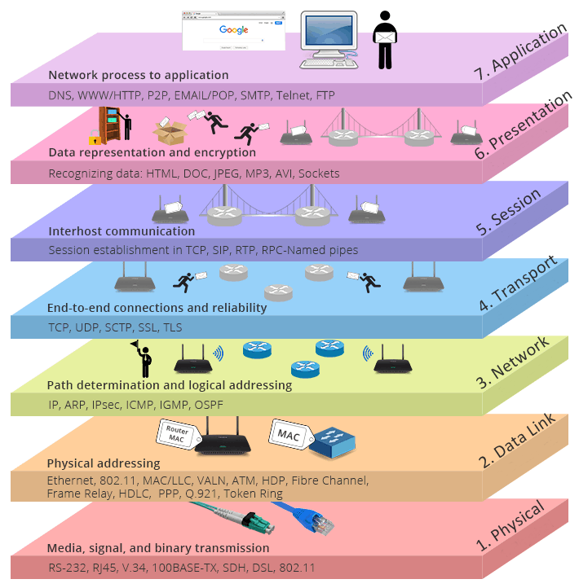
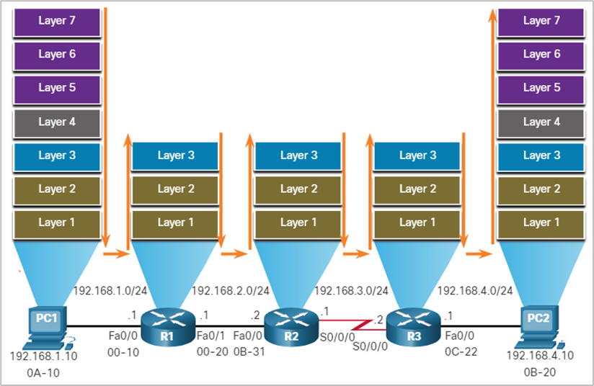
The OSI Model
Notes:
The OSI Model
7. Application – DNS, WWW/HTTP, P2P, EMAIL/POP, SMTP, Telnet, FTP
6. Presentation – Recognizing data: HTML, DOC, JPEG, MP3, AVI, Sockets
5. Session – Session establishment in TCP, SIP, RTP, RPC-Named pipes
4. Transport – TCP, UDP, SCTP, SSL, TLS
3.Network – IP, ARP, IPSec, ICMP, IGMP, OSPF
2. Data Link: Ethernet, 802.11, MAC/LLC, VLAN, ATM, HDP, Fibre Channel, Frame Relay, HDLC, PPP, Q.291, Token Ring
1. Physical: RS-232, RJ-45, V.34, 100BASE-TX, SDH, DSL, 802.11

Slide 6
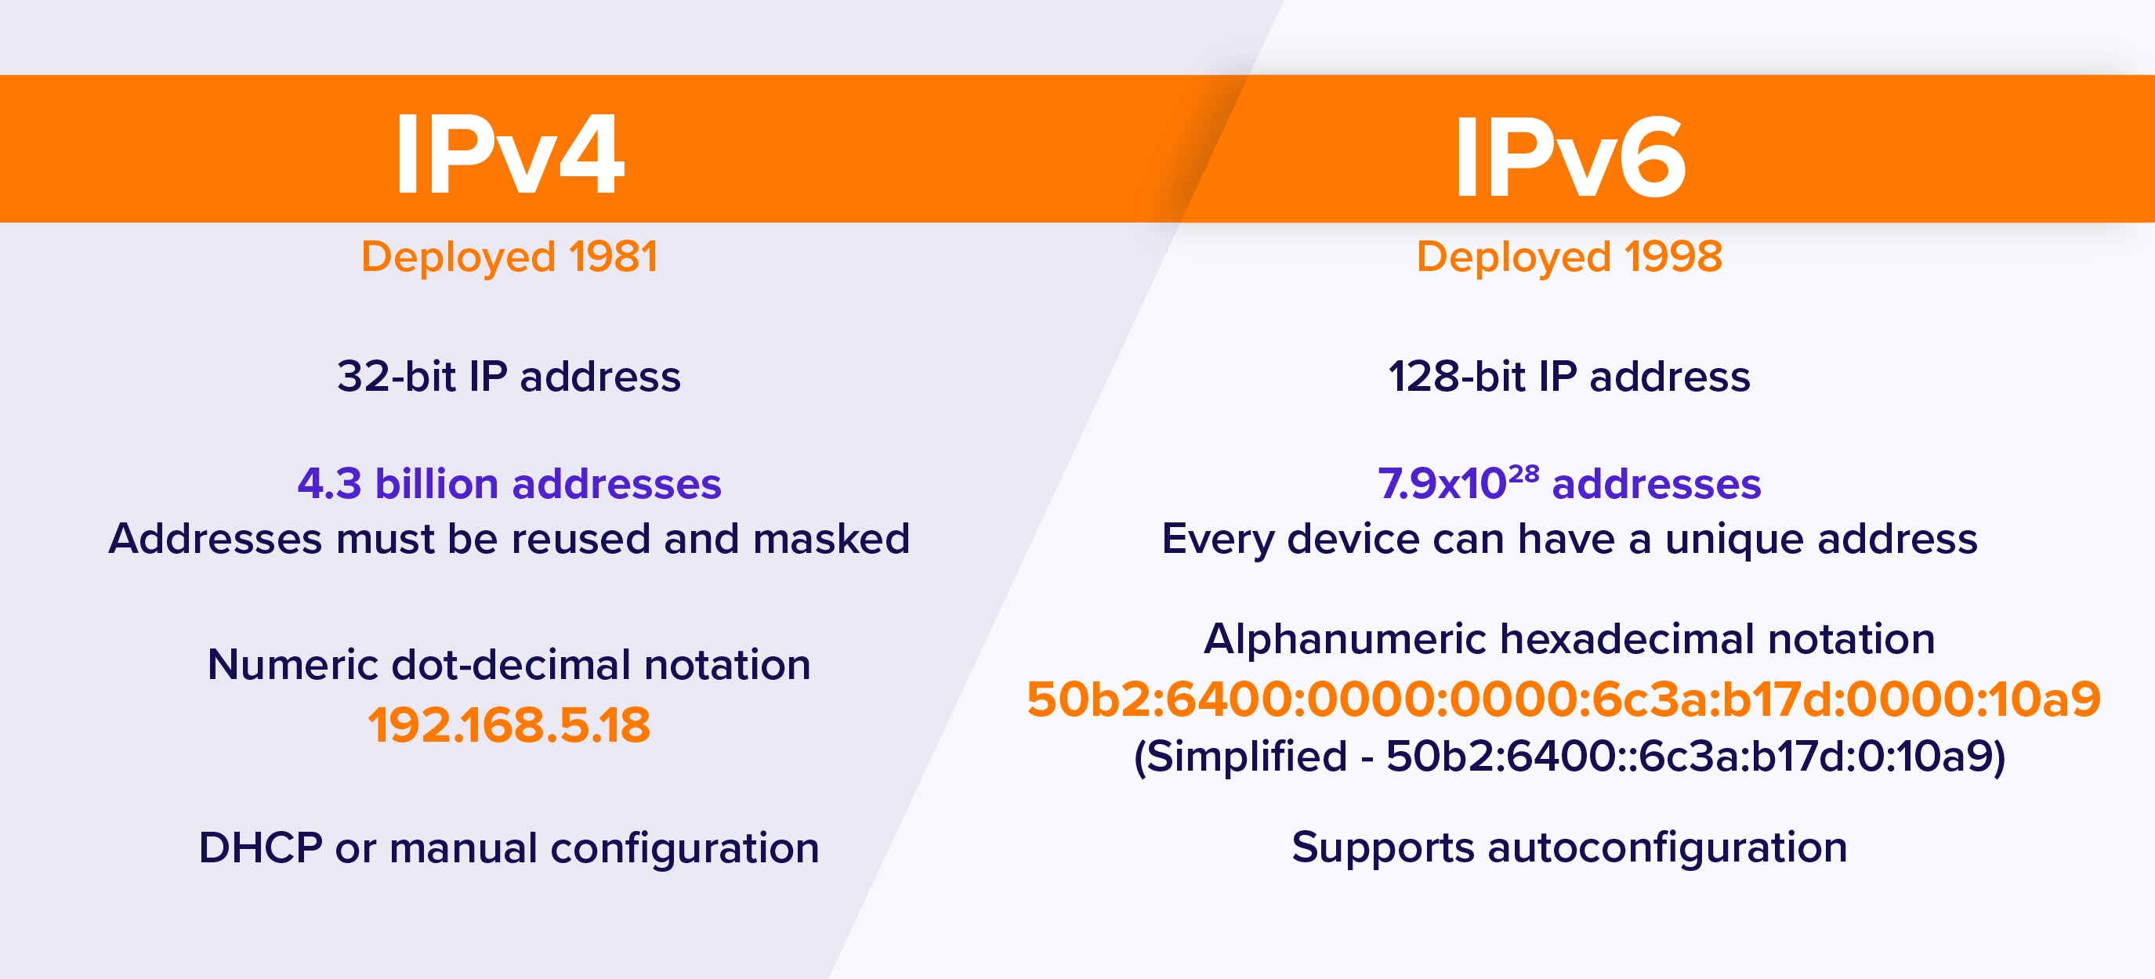
IPv4 vs. IPv6
Notes:
Public IP addresses distribution:
https://www.ripe.net/
https://bgp.he.net/

Slide 7
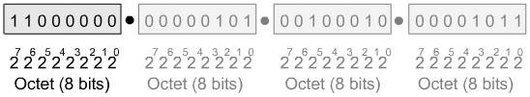
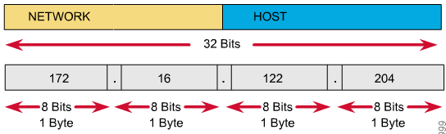
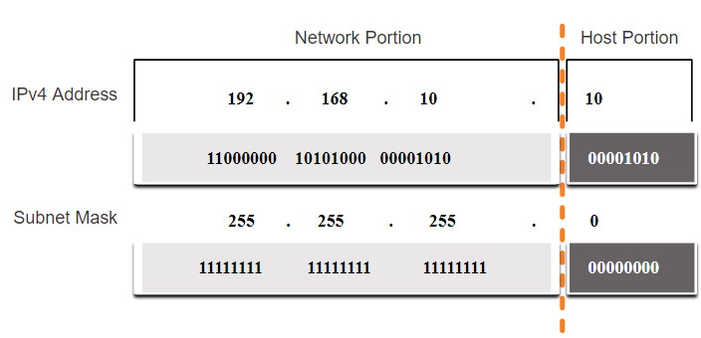
What is Subnet mask?
IP Address as a 32-Bit Binary Number
192
5
34
11
Subnet Mask
IP addresses are logical addresses (not physical)
32 bits.
Includes a network ID and a host ID.
Every host must have a unique IP address.
IP addresses are assigned by a central authority (RIPE).
MASK -determines which part of an IP address is the network field and which part is the host field
Notes:
Public IP addresses distribution:
https://www.ripe.net/
https://bgp.he.net/

Slide 8
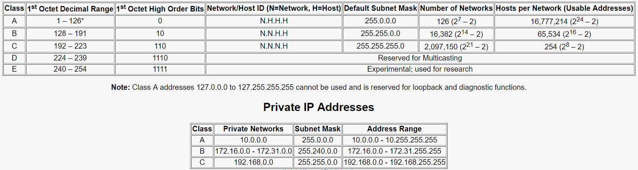
How IPv4 addresses are divided?
Notes:
Public IP addresses distribution:
https://www.ripe.net/
https://bgp.he.net/

Slide 9
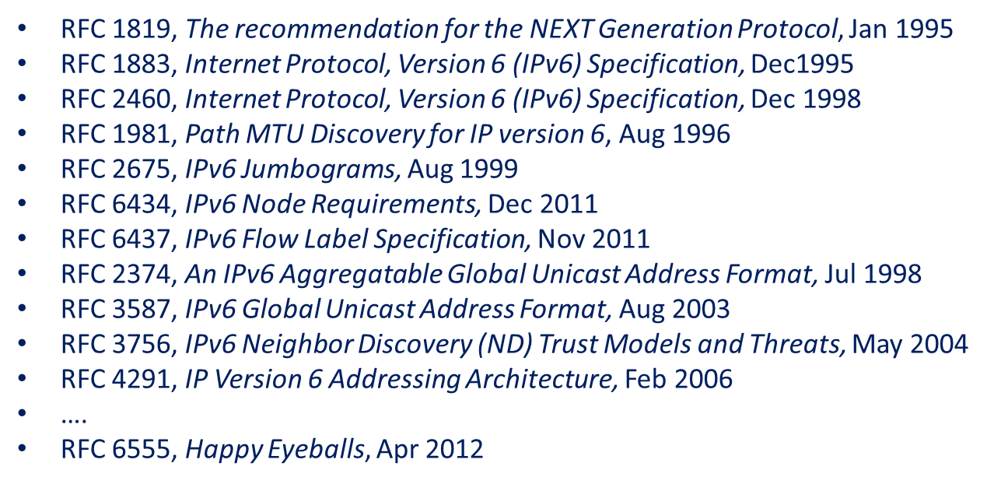
IPv6 – get ready
Notes:
Public IP addresses distribution:
https://www.ripe.net/
https://bgp.he.net/

Slide 10
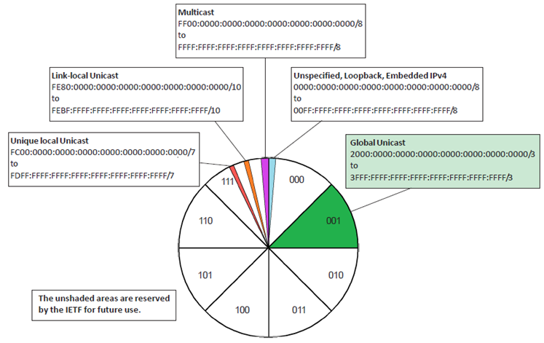
IPV6 current distribution
Source: IPv6 Fundamentals, Rick Graziani
Notes:
Public IP addresses distribution:
https://www.ripe.net/
https://bgp.he.net/

Slide 11

IPV6 representations
Rule 1: Leading 0s (zeroes) in any 16-bit section can be omitted.
Address before omission:
2001:0DB8:0001:5270:0127:00AB:CAFE:0E1F /64
Address after omission:
2001: DB8: 1:5270: 127: AB:CAFE: E1F /64
Rule2: use Double colon
Notes:
Public IP addresses distribution:
https://www.ripe.net/
https://bgp.he.net/

Slide 12
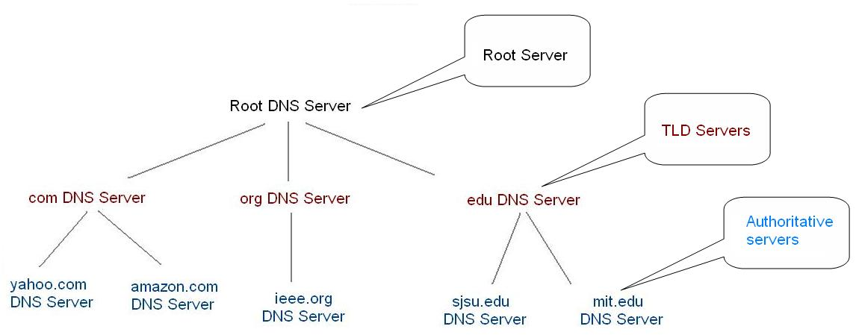
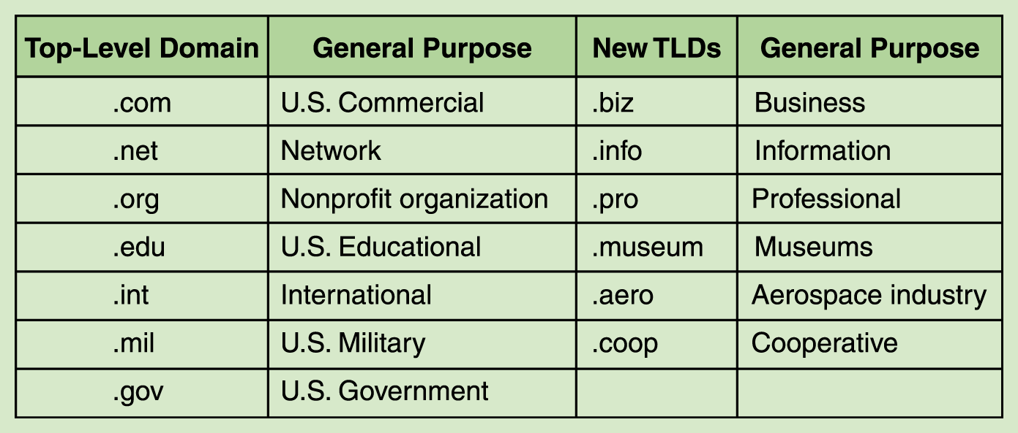
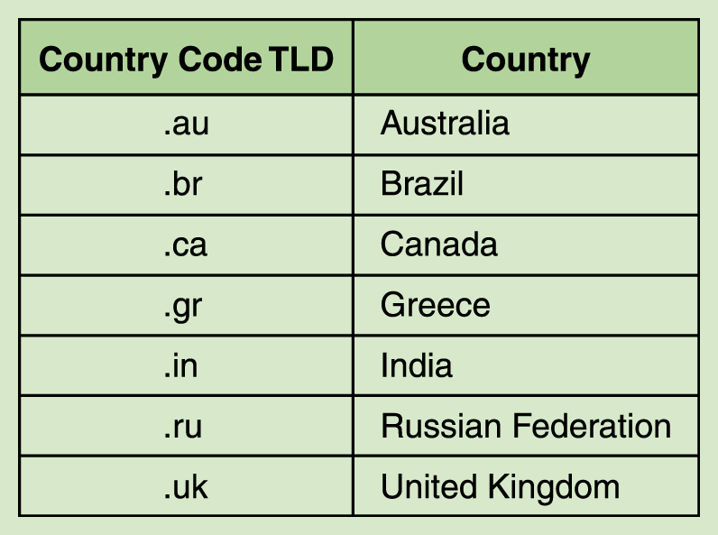
Domain Name System
IP addresses are complicated, I want something easier..
DNS Server types
By hierarch structure:
Root Servers
TLD Servers
Authoritative
By operation mode:
Authoritative
Resolvers
By config management:
Master
Slave
DNS Record types
A (Host address)
NS (Name Server)
SOA (Start Of Authority)
AAAA (IPv6 host address)
CNAME (Canonical name for an alias)
MX (Mail eXchange)
Notes:
Unicast Address
Broadcast Address
Multicast Address
INFO: https://packetlife.net/media/library/13/Wireshark_Display_Filters.pdf
https://packetlife.net/media/library/12/tcpdump.pdf

Slide 13
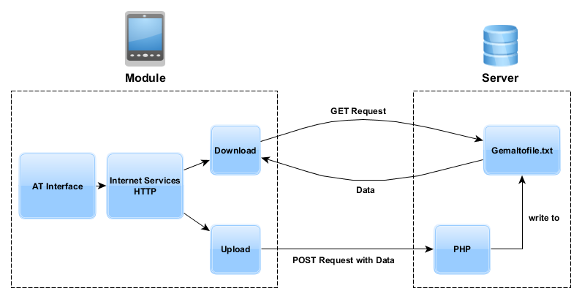
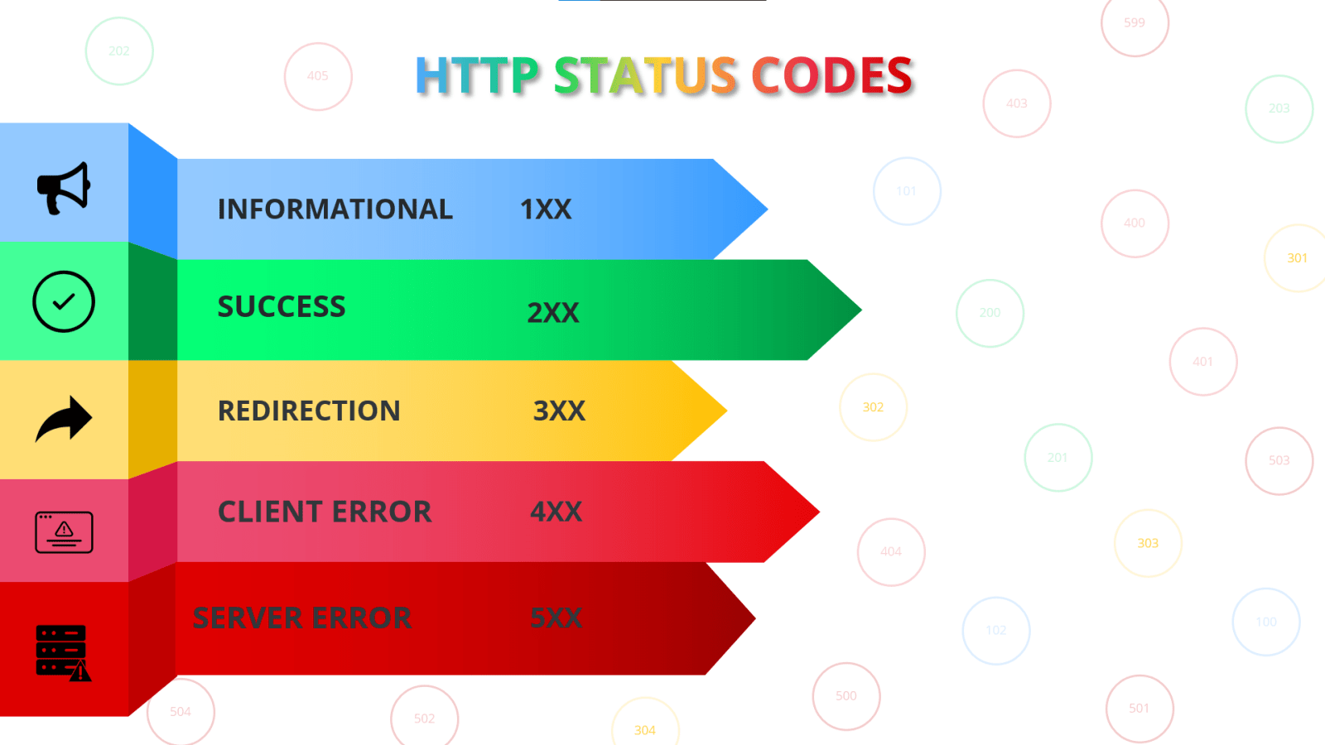
HTTP Requests
HTTP versions:
1.0
1.1
2.0
….
HTTP request
Schema: HTTP, HTTPS
Method: GET, POST, PUT, DELETE
Headers: authentication, cookie support
Payload: XML, JSON

Slide 14
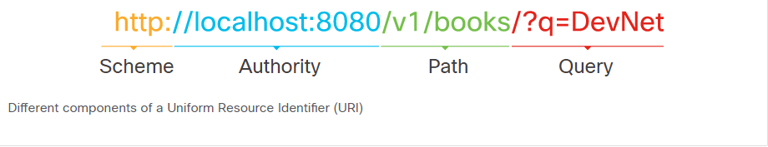
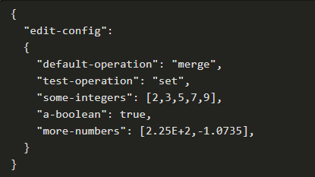
HTTP request
HTTP Method | Action | Description
POST | Create | Create a new object or resource.
GET | Read | Retrieve resource details from the system.
PUT | Update | Replace or update an existing resource.
PATCH | Partial Update | Update some details from an existing resource.
DELETE | Delete | Remove a resource from the system.
HTTP Status Code | Status Message | Description
200 | OK | Request was successful and typically contains a payload (body)
201 | Created | Request was fulfilled and the requested resource was created
202 | Accepted | Request has been accepted for processing and is in process
400 | Bad Request | Request will not be processed due to an error with the request
401 | Unauthorized | Request does not have valid authentication credentials to perform the request
403 | Forbidden | Request was understood but has been rejected by the server
404 | Not Found | Request cannot be fulfilled because the resource path of the request was not found on the server
500 | Internal Server Error | Request cannot be fulfilled due to a server error
503 | Service Unavailable | Request cannot be fulfilled because currently the server cannot handle the request
Header Key | Example Value | Description
Content-Type | application/json | Specify the format of the data in the body

Slide 15
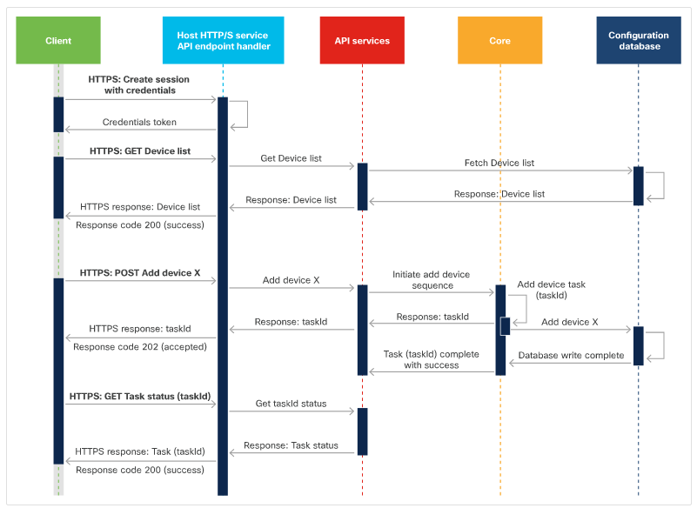
API

Slide 16

Let’s exercise
https://apikijangportal.bnm.gov.my/openapi

